Slide 1



Java.IL Meetup
Object auditing and diff framework
Elad Hirsch
Fullstack Dev @ IDI
https://il.linkedin.com/in/eladhirsch
JAN 21 / TLV, Israel

Slide 2


Full-Stack Dev/Team Lead @ IDI

Slide 3
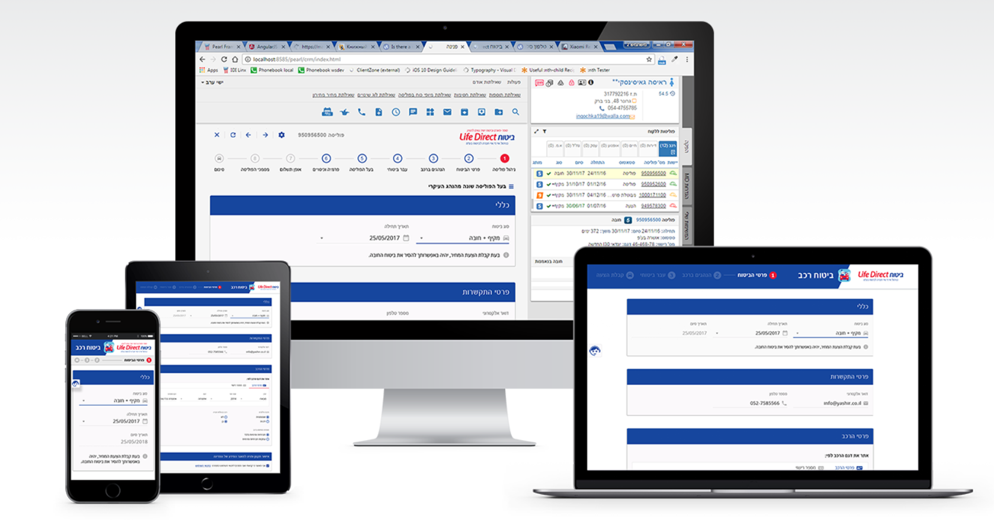

Slide 4

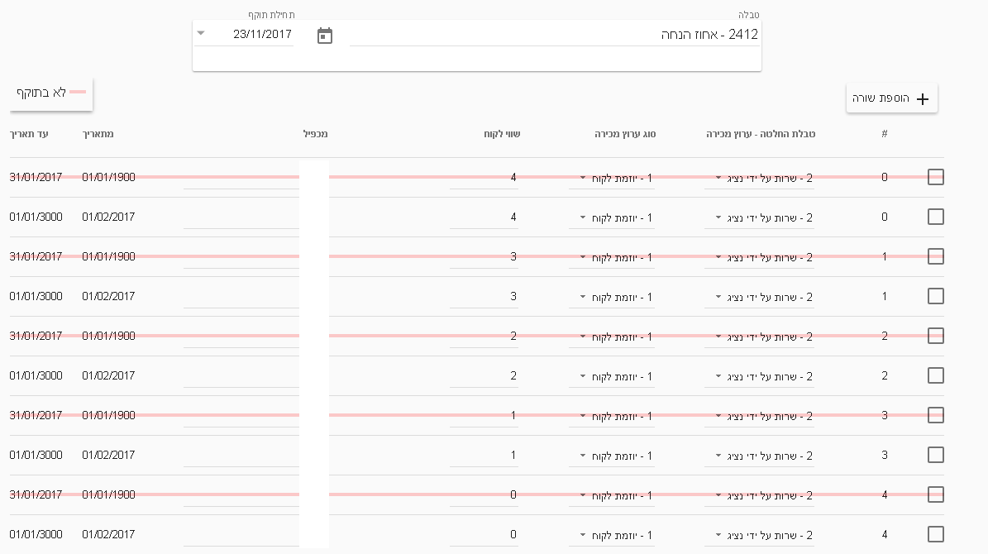
MD Editor
- Desicion tables

Slide 5




Architecture
Super Users
Application
MD Editor
MD
Rule Engine
Rules
QA/Dev
Decision tables

Slide 6

Super Users
Application
MD Editor
MD
Rule Engine
Rules
QA/Dev
Decision tables

Slide 7
Configuration control
Need to keep track of all configuration changes (diff , date , user , description…)
In a case of conflict – be able to send the user diff and re-approve changes
Without modify our MD schema

Slide 8



Tech Spec
Java 8 + Spring eco-system
JPA / ORM specification
Snapshot - Object Serialization

Slide 9


Architecture
^{Javers Repo}
MD Editor
^{Diff / Restore / Query}
^{Commit}
^{Spring Data} ^{CRUD Repositories}
^{MD-DB}

Slide 10
Architecture
^{Javers Repo}
MD Editor
^{Diff / Restore / Query}
^{Commit}
^{Spring Data} ^{CRUD Repositories}
^{MD-DB}

Slide 11
Architecture
^{Javers Repo}
MD Editor
^{Diff / Restore / Query}
^{Commit}
^{Spring Data} ^{CRUD Repositories}
^{MD-DB}

Slide 12
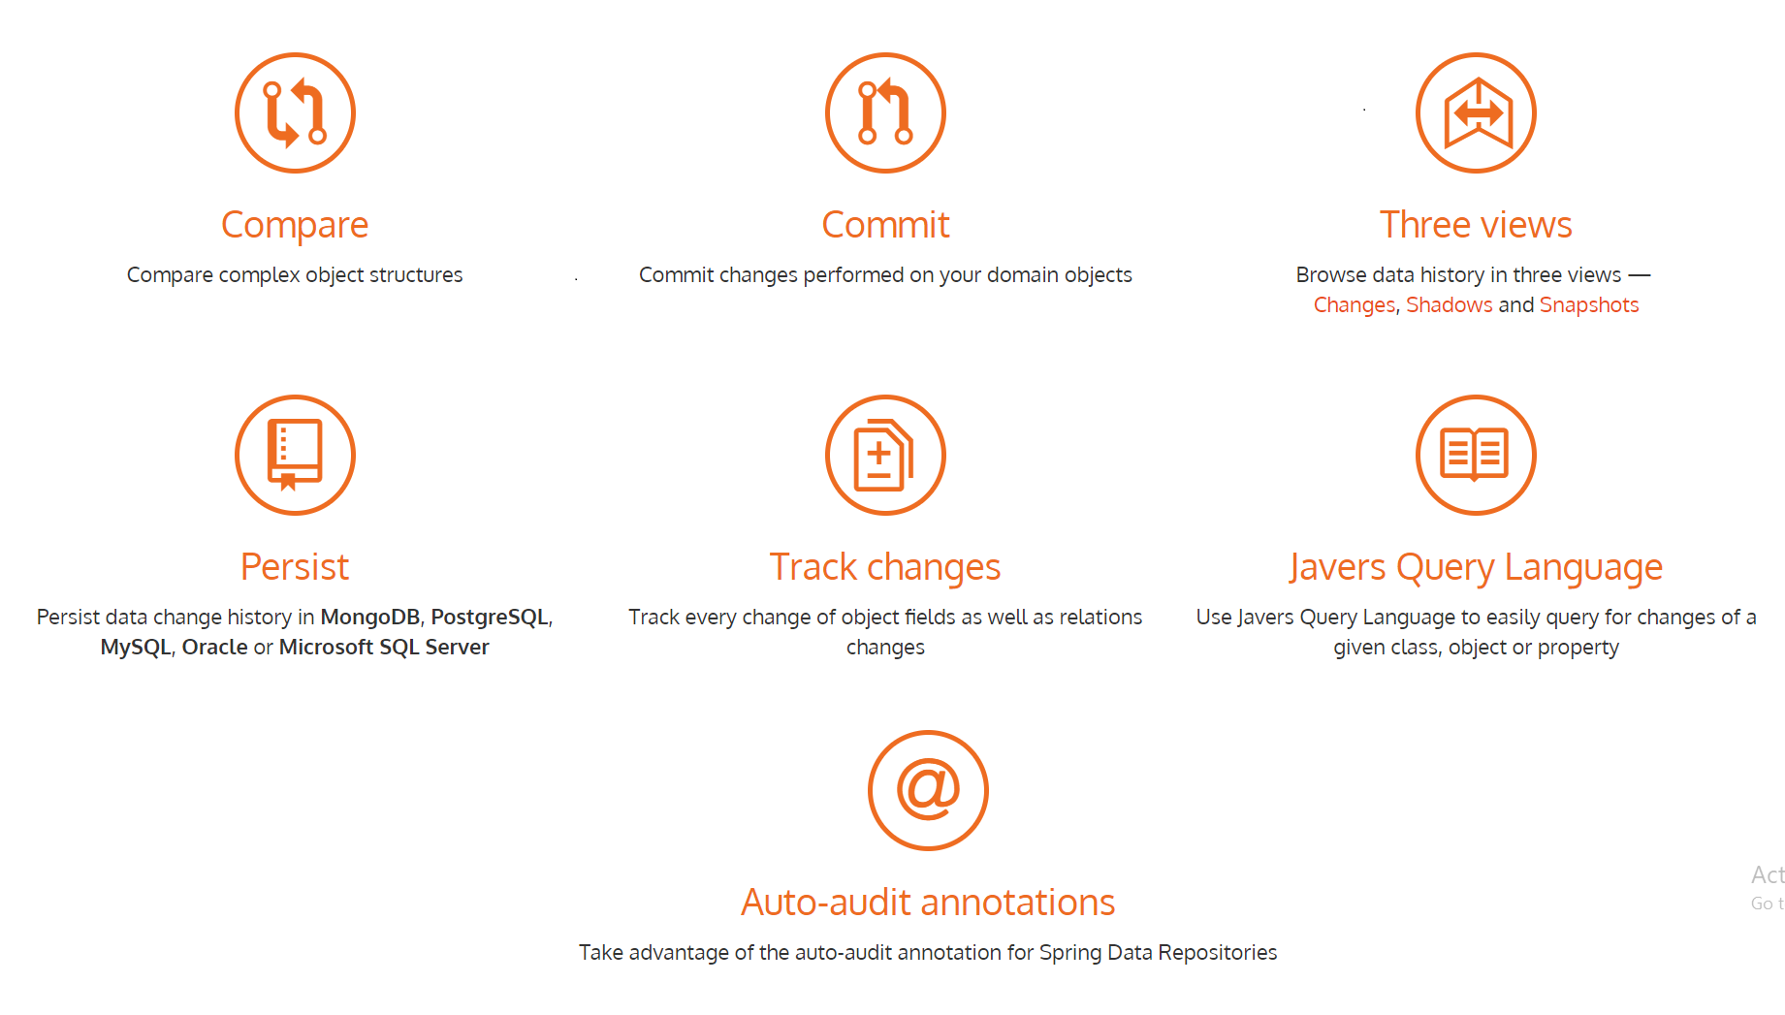


Slide 13
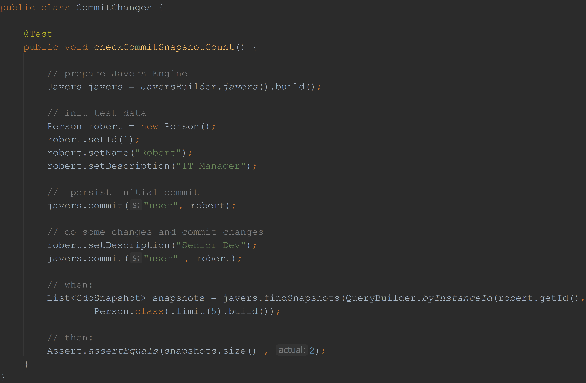

Slide 18
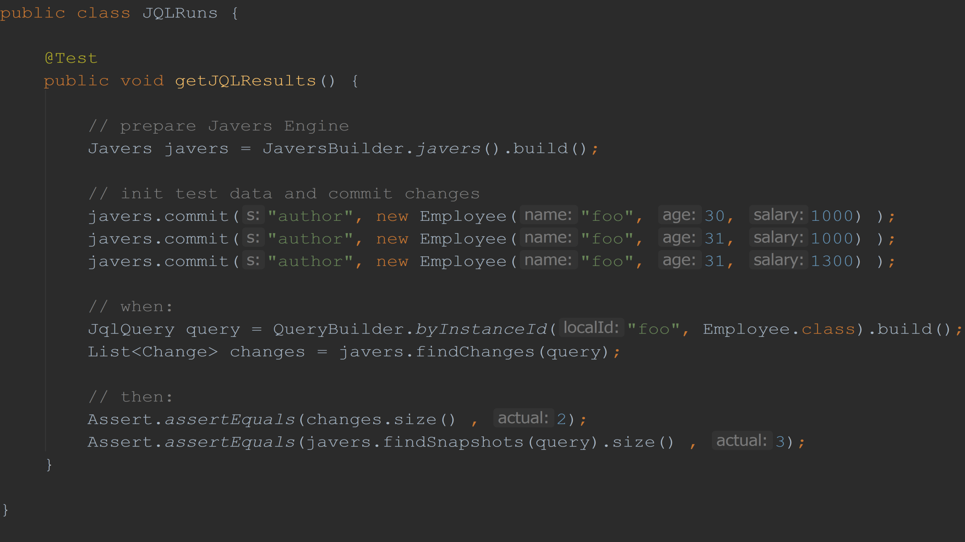

Slide 21
findSnapshots - include initial commit
findChanges - exclude initial commit

Slide 23
_{Demo}
https://github.com/eladh-sessions/JavaIL-javers-permisson-auditing
JAN 21/ TLV, Israel

Slide 24
What's next – Javers UI

Slide 25
_{Thank you!}
Elad Hirsch
Fullstack Dev @ IDI
https://il.linkedin.com/in/eladhirsch
JAN 21 / TLV, Israel

